Slide 1

New Restaurants Plan and Analysis
Data Science Project,New York

Slide 2
Introduction
Business Understanding:
-It helps clarify the goal of the entity asking the question.
-Business Clients are interested in figuring out the best locations to open the New IndiaDhaba which includes dishes made from India Flavors and Major Ingredients.
-Interested: Authentic Indians Dhabas owners who wants to explore the Indian Cuisines/Dishes.
-Business requirement we have to search the most prominent choice/location for restaurants with more of he requirements includes.

Slide 3
Data Requirement and Understanding
the chosen analytic approach determines the data requirement
In the initial data collection , we have to identify and gather the available data resources
These can be in the form of structured, unstructured, and even semi-structured data relevant to the problem domain.
Web Scraping for find out the most visited and famous places for foods in New York City.
Link: https://www.thrillist.com/eat/new-york/most-famous-nyc-restaurants
It's important to understand its content and assess its quality, will proceed to Data Collection

Slide 4
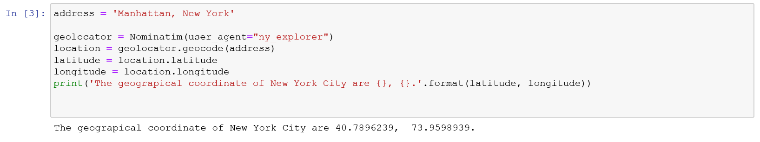
Discover only interesting preliminary insights.
Determine whether additional data is necessary to fill any gaps in the data.
Transform the data into a pandas data frame The next task is essentially transforming this data of nested Python dictionaries into a pandas data frame. So let's start by creating an empty data frame

Slide 5
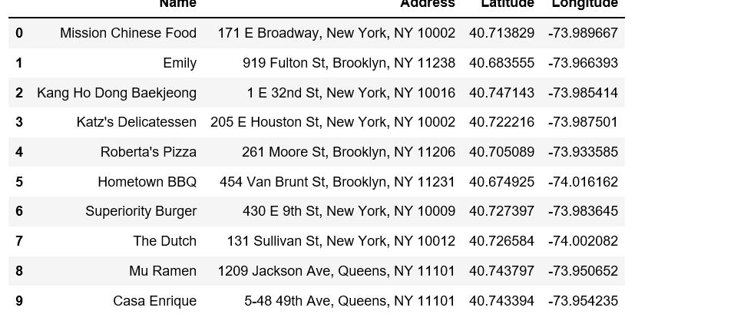

Slide 6
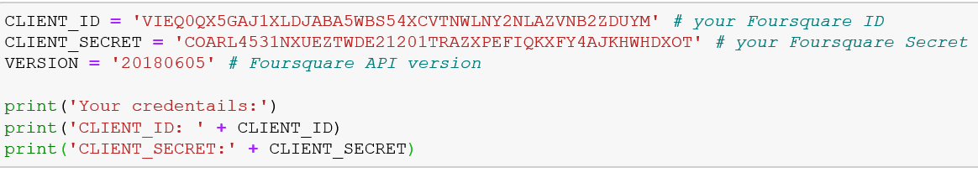
Foursquare API
we are going to start utilizing the Foursquare API to explore the neighborhoods and segment them. Define Foursquare Credentials and Version.

Slide 7
Methodology
In this project we will direct our efforts on detecting areas of New York that have low restaurant density, particularly those with low number of Indian restaurants.
Second step in our analysis will be calculation and exploration of 'restaurant density' across different areas of New York to identify a few promising areas close
In third and final step we will focus on most promising areas and within those create clusters of locations that meet some basic requirements
We will present map of all such locations but also create clusters (using k-means clustering) of those locations to identify general zones / neighborhoods / addresses
We should be a starting point for final 'street level' exploration and search for optimal venue location by stakeholders.

Slide 8
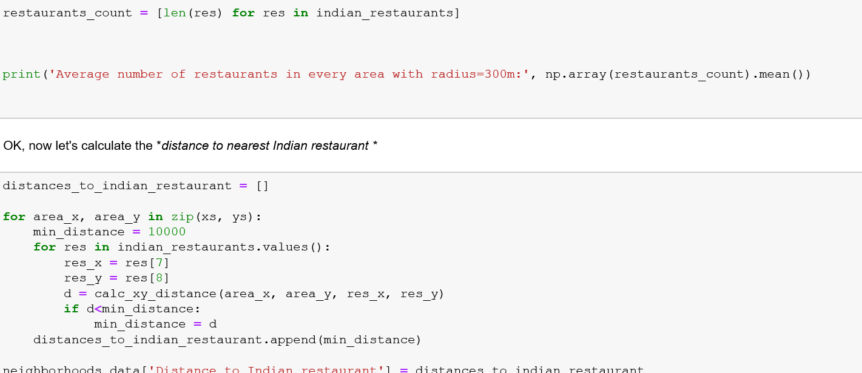
Analysis
Let's perform some basic explanatory data analysis and derive some additional info from our raw data. First let's count the number of restaurants in every area candidate:

Slide 9
Results and Discussion
Our analysis shows that although there is a great number of restaurants in New York, there are pockets of low restaurant density fairly close to city center.
So we focused our attention to areas with low density of Indian restaurants.
After directing our attention to this more narrow area of interest those locations were then filtered so that those with less restaurants .
Those location candidates were then clustered to create zones of interest which contain greatest number of location candidates.
it is entirely possible that there is a very good reason for small number of restaurants in any of those areas, reasons which would make them unsuitable for a new restaurant regardless of lack of competition in the area.

Slide 10
Conclusion
this project was to identify New York areas close to center with low number of restaurants (particularly Indian restaurants) in order to aid stakeholders in narrowing down the search for optimal location for a new Indian restaurant.
From Foursquare data we have first identified general collection of locations which satisfy some basic requirements regarding existing nearby restaurants.
Clustering of those locations was then performed in order to create major zones of interest (containing greatest number of potential locations) and addresses of those zone centers were created to be used as starting points for final exploration by stakeholders.
Final decision on optimal restaurant location will be made by stakeholders based on specific characteristics of neighborhoods and locations in every recommended zone, taking into consideration additional factors like attractiveness of each location (proximity to park or water)etc.

Slide 11
Thank You.

